Slide 1
Creating a Spring Boot Web App
Creating a web application
Additional techniques

Slide 2
1. Creating a Web Application
Getting started with IntelliJ
Creating a web app in IntelliJ
Application structure
Maven POM file
Code artifacts
Adding an HTML home page
Running the application
Pinging the application

Slide 3
Getting Started with IntelliJ
IntelliJ has excellent support for Spring
E.g. create Spring Boot apps (via Spring Initializr)
E.g. create Spring Framework apps
We've provided an IntelliJ project with full demos
Start IntelliJ
In the dialog box, click Open Project
Select the FullStackDev folder
3

Slide 4
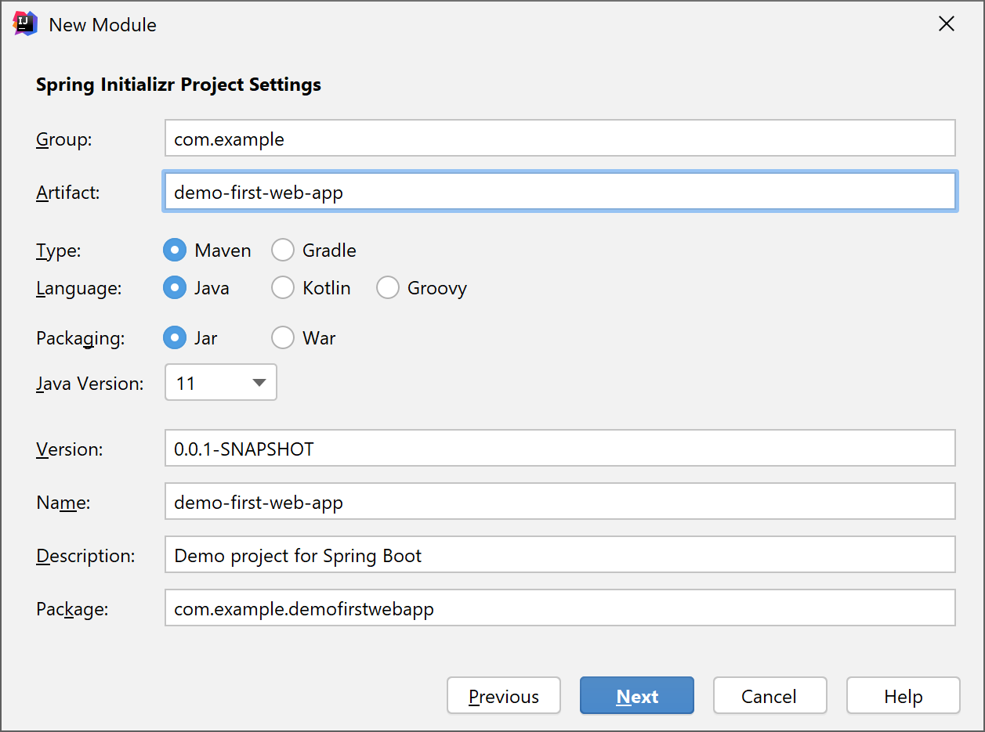
Creating a Web App in IntelliJ (1 of 3)
To create a new module, click File | New | Module
Select Spring Initializr, click Next, and enter these details:
Type: Maven
Language: Java
Packaging: Jar
Java Version: 11 (for example)
4

Slide 5
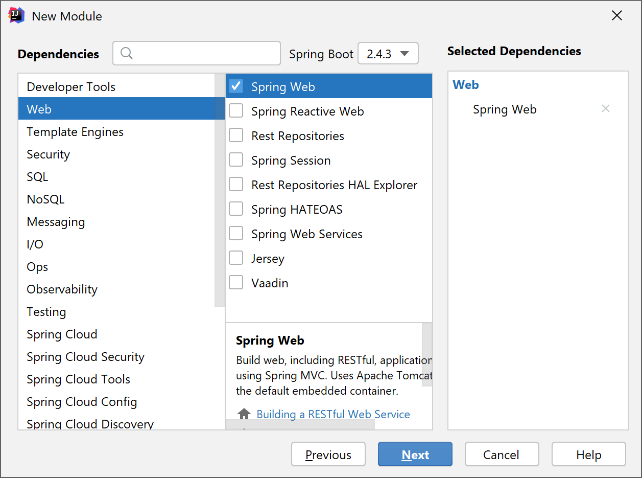
Creating a Web App in IntelliJ (2 of 3)
Select the project dependencies you want
E.g. select the Spring Web dependency
5

Slide 6
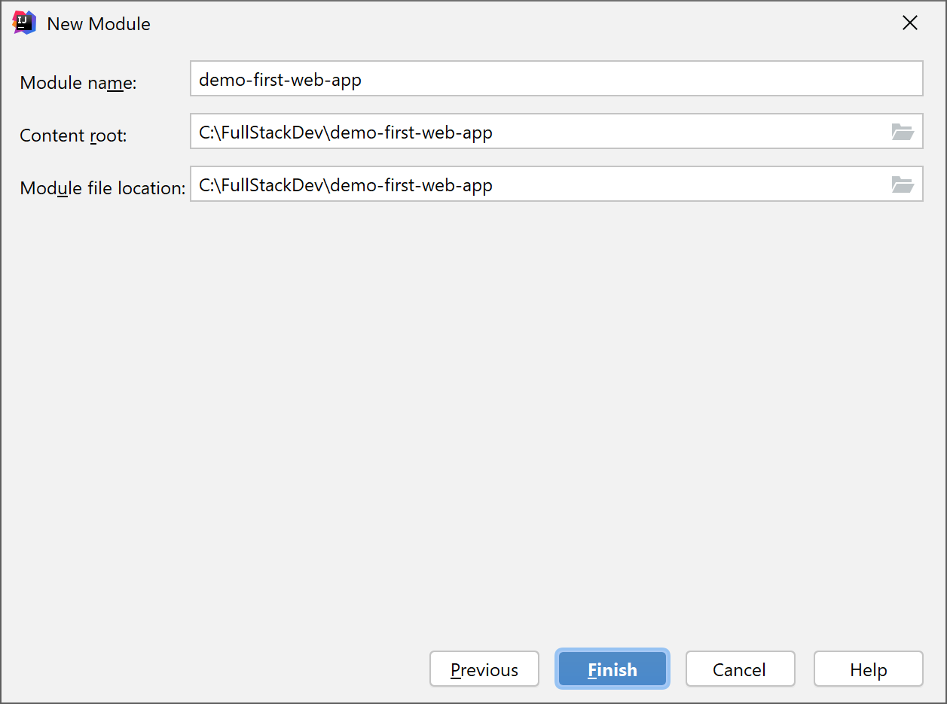
Creating a Web App in IntelliJ (3 of 3)
Click Finish
IntelliJ generates your module
6

Slide 7
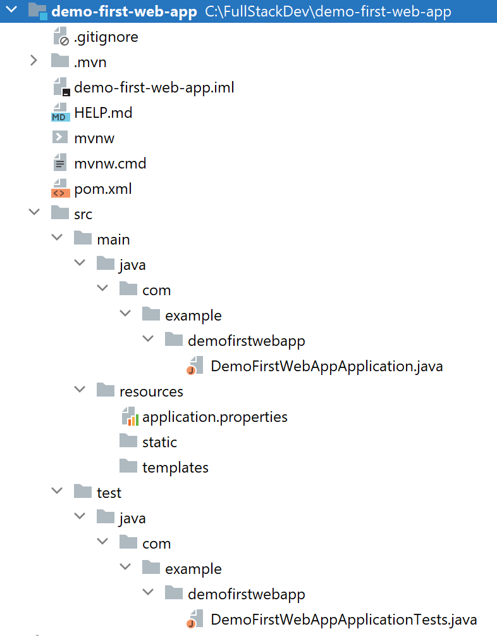
Application Structure
The generated app is a regular Maven web app project
To ensure IntelliJ can build it:
Right-click pom.xml
Click Add as Maven Project
7

Slide 8
Maven POM File
Here are the relevant sections in the Maven POM file
<project … >
…
<parent>
<groupId>org.springframework.boot</groupId>
<artifactId>spring-boot-starter-parent</artifactId>
<version>2.4.3.RELEASE</version>
<relativePath/>
</parent>
<dependencies>
<dependency>
<groupId>org.springframework.boot</groupId>
<artifactId>spring-boot-starter-web</artifactId>
</dependency>
<dependency>
<groupId>org.springframework.boot</groupId>
<artifactId>spring-boot-starter-test</artifactId>
<scope>test</scope>
</dependency>
</dependencies>
…
Parent POM
Spring Boot web dependency
Spring Boot test dependency
pom.xml
8

Slide 9
Code Artifacts
Here's the generated application code
@SpringBootApplication is equivalent to:
@Configuration
@EnableAutoConfiguration
@ComponentScan
import org.springframework.boot.SpringApplication;
import org.springframework.boot.autoconfigure.SpringBootApplication;
@SpringBootApplication
public class DemoFirstWebAppApplication {
public static void main(String[] args) {
SpringApplication.run(DemoFirstWebAppApplication.class, args);
}
}
DemoFirstWebAppApplication.java
9

Slide 10
Adding an HTML Home Page
We can just add static content directly
In the src\main\resources\static folder
E.g. let's add a simple HTML page
<!DOCTYPE html>
<html>
<head>
<title>Home</title>
</head>
<body>
Prynhawn da pawb o Gymru!
</body>
</html>
index.html
10

Slide 11
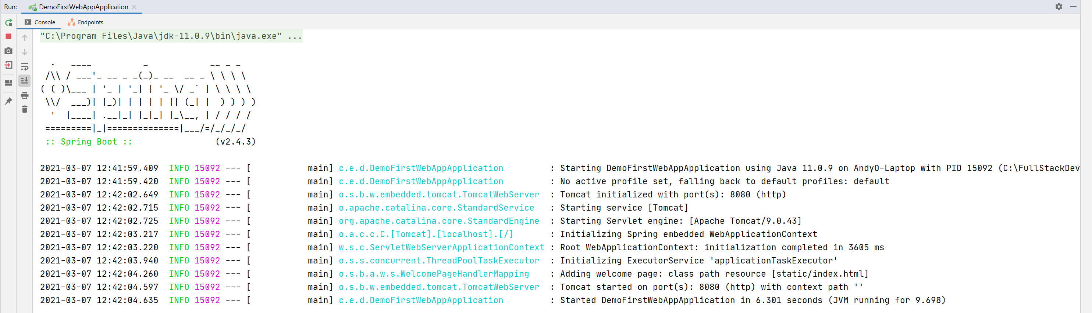
Running the Application
To run the application:
Right-click the Java app file, then click Run
Compiles code, bundles into a JAR, then runs the JAR
The application has an embedded Tomcat web server
11

Slide 12
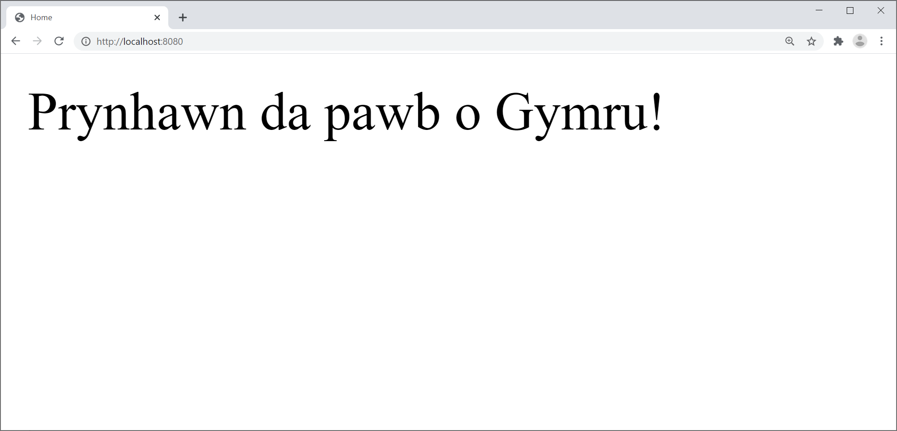
Pinging the Application
Open a browser and navigate to http://localhost:8080
Renders index.html, because this is a default filename
12

Slide 13
2. Additional Techniques
Overview of application properties
Editing application properties
Restarting the application
Implementing a simple REST service
Pinging the REST service

Slide 14
Overview of Application Properties
Spring Boot applications have a standard text file named application.properties
The recommended place to set application properties
i.e. name=value pairs
You can also use YAML if you like
YAML = "YAML Ain't Markup Language"
14

Slide 15
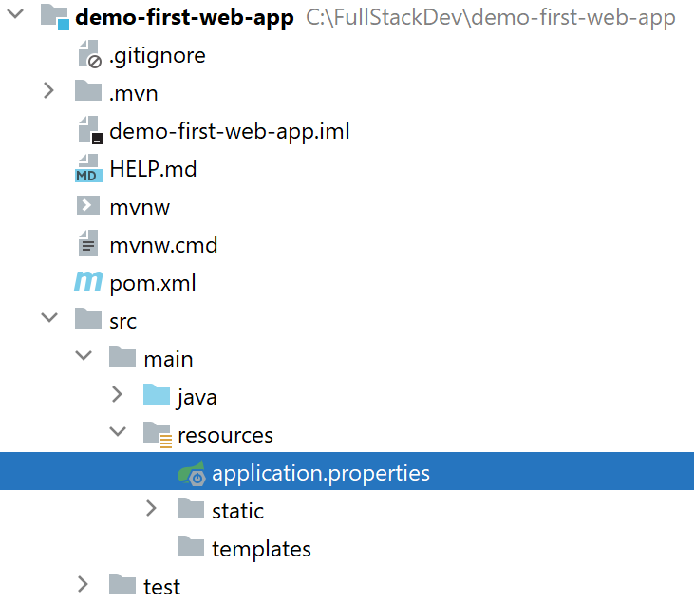
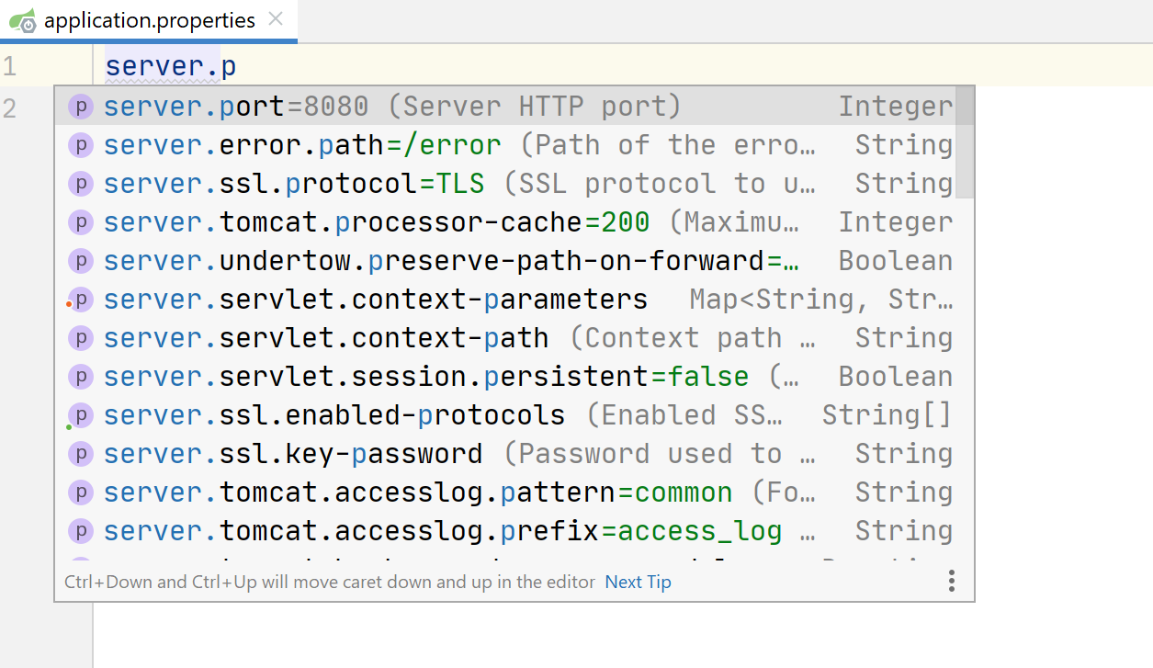
Editing Application Properties
To help you edit application.properties, IntelliJ provides a Spring Properties Editor tool
Provides nice content assistance and error checking
server.port=8111
15

Slide 16
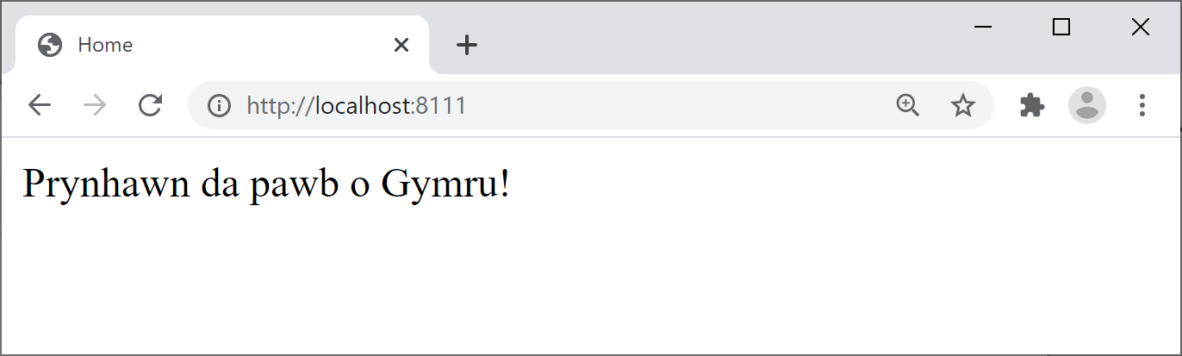
Restarting the Application
Restart the application, and verify Tomcat starts on the new port number, 8111
Ping the Web server using the new port number, 8111
16

Slide 17
Implementing a Simple REST Service
It's easy to implement a REST service
Add a class and annotate with @RestController
Add methods and annotate with @RequestMapping
package com.example.demofirstwebapp;
import org.springframework.web.bind.annotation.RequestMapping;
import org.springframework.web.bind.annotation.RequestParam;
import org.springframework.web.bind.annotation.RestController;
@RestController
public class HelloController {
@RequestMapping("/hello")
public String hello(@RequestParam String name) {
return "Hello " + name;
}
}
HelloController.java
17

Slide 18
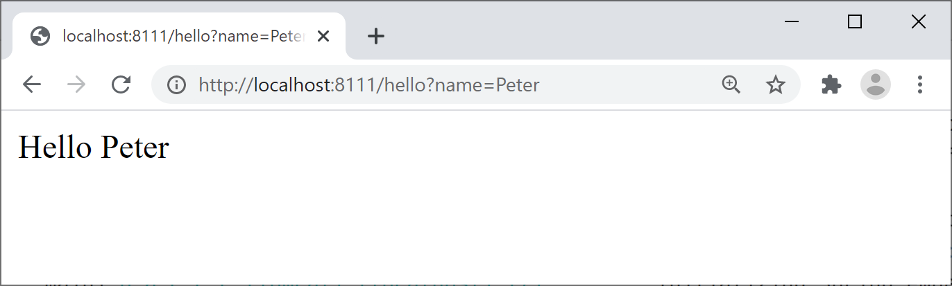
Pinging the REST Service
Restart the application and browse to a URL such as:
http://localhost:8111/hello?name=Peter
18

Slide 19
Summary
Creating a web application
Additional techniques

